Slide 1
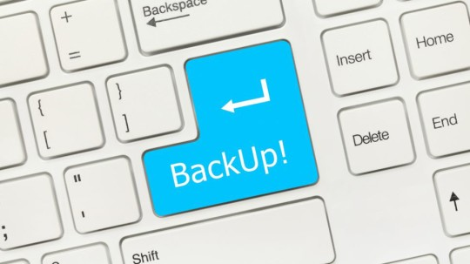
Automatic data backup
Sue Kayton
September 2019

Slide 2
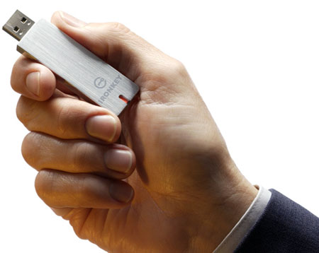
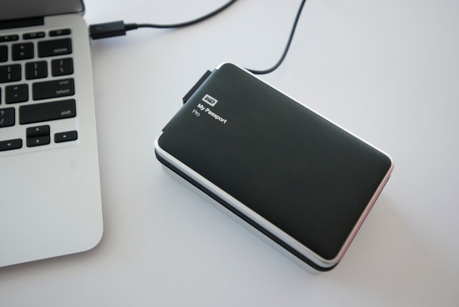
Backup methods
USB flash drive
(beware static electricity!)
External hard drive
(take it off-site!)
Cloud backup
(can be automatic)

Slide 3
Why back up off-site?
Fire
Theft
Earthquake
Roof leak
Power surge

Slide 4
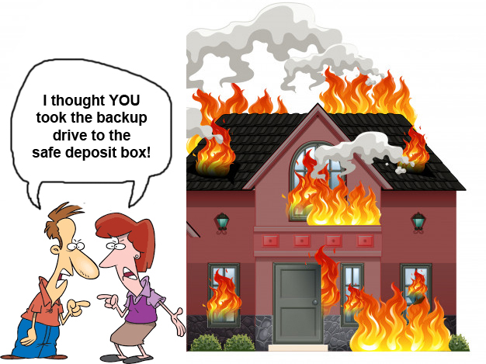

Slide 5
Why back up automatically?
You won’t forget to do it
Less hassle
Never lose data again

Slide 6
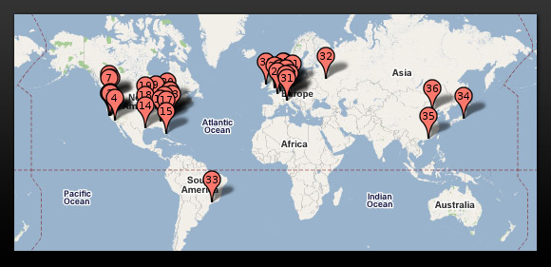
The Cloud – hundreds of hyper-scale computer centers

Slide 7
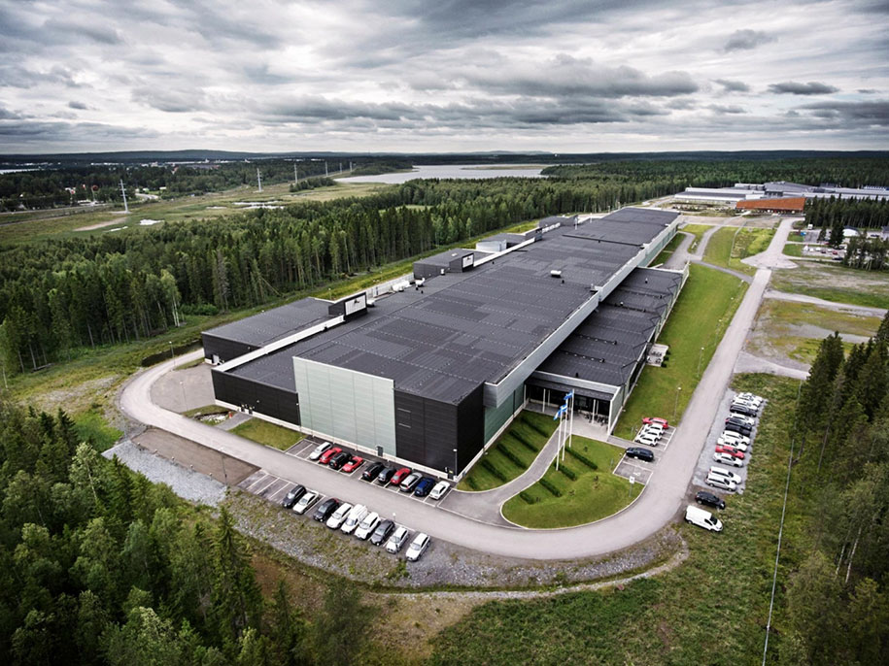
Server farm (data center)

Slide 8
Inside a server farm

Slide 9
What these servers do
Store data
Perform computations
Back up data
Control access to data
Show you websites

Slide 10
Web services
And a bit from

Slide 11
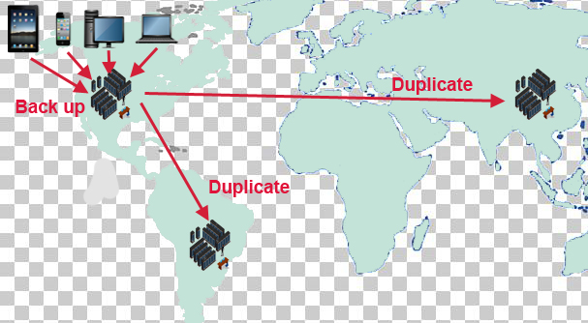

Slide 12
Features
Automatic data backup
Automatic photo backup
Share files
Recover deleted files

Slide 13
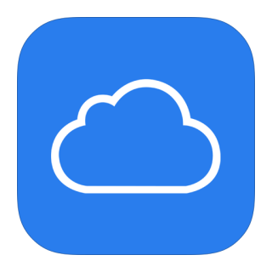
The Big Four
Google Drive (Google One)
Dropbox
Microsoft OneDrive
iCloud

Slide 14
 | Google Drive (Google One) | Dropbox | iCloud | OneDrive
Free data storage | 15 GB | 2 GB | 5 GB | 5 GB
Yearly cost | $100 / 2TB | $120 / 2TB | $120 / 2 TB | $70 / 1 TB
Number of devices synced for free | Unlimited | 3 | Unlimited | Unlimited
Unlimited free photo storage | √
Choose folders to back up | √
Shows backup progress | √
Bonus features | Google Docs Google Sheets Google Slides | Text search | Back up contacts from iPhone | 1TB included with Office 365

Slide 15
30-day “rewind”
Recover deleted files
Kept for 30 days
Up to 5 versions (Dropbox) or 10 versions (Google Drive)

Slide 16
Beware!
Keep your payment information current
- credit cards expire!
Write down your passwords!
Huge Outlook files won’t back up automatically

Slide 17
Google Backup and Sync (Google Drive)
Built in to Android phones and tablets
Available on Windows, Mac, iPhone, iPad
Automatic backup of your files
Synchronize data between computers
Transfer data to new computer
Access data from smartphone or tablet
Access data from anywhere
15 GB free storage plus unlimited photos
Pay for more space if needed
Share data with family, friends or co-workers

Slide 18
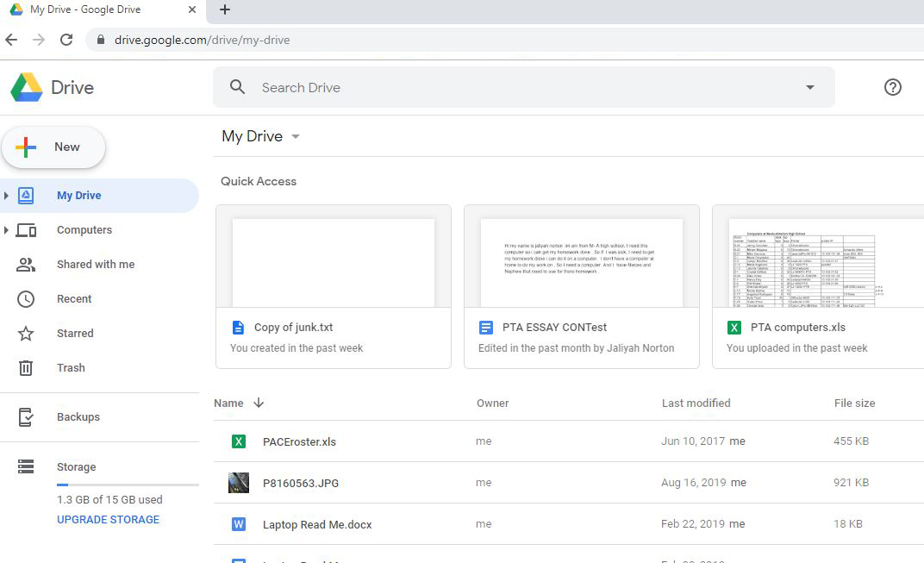
Google Drive

Slide 19
Google Drive
These files are manually uploaded and can be
synchronized to other computers and devices
These files are automatically uploaded from the
computers running Google Backup and Sync

Slide 20
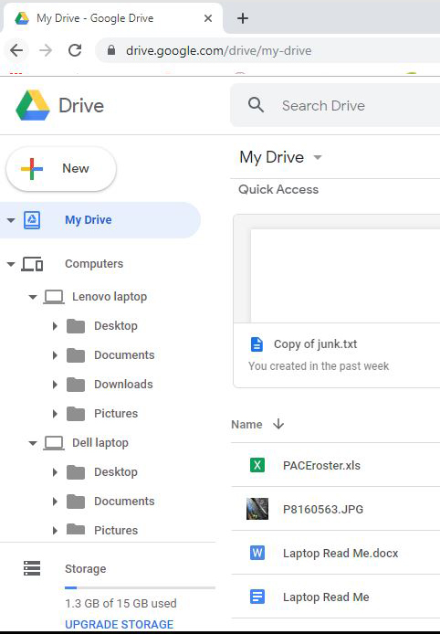

Slide 21
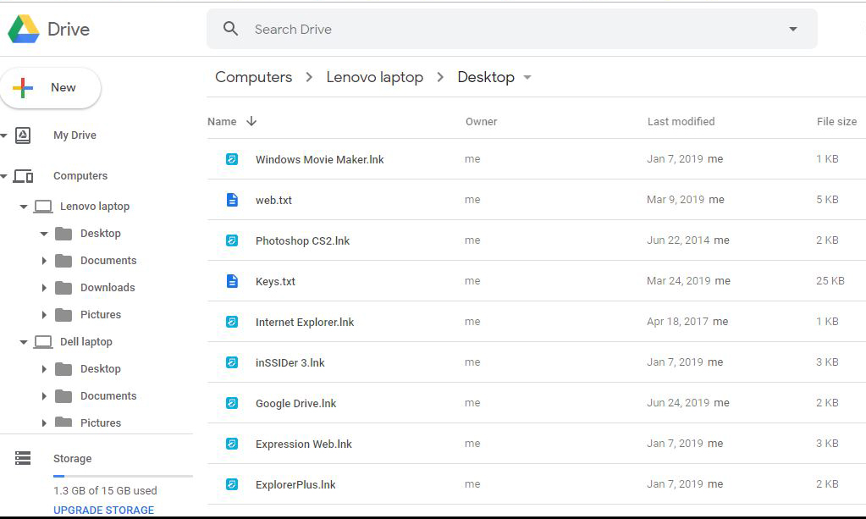
Transfer files to another device

Slide 22
Google Drive
Excellent tutorial from C-net including how to install Google Backup and Sync
https://www.cnet.com/how-to/get-started-with-googles-backup-and-sync-app/
Excellent tutorial from HowToGeek
https://www.howtogeek.com/228989/how-to-use-the-desktop-google-drive-app/

Slide 23
Google Photos
Built in to Android phones and tablets
Available for Windows, Mac, iPhone, iPad
Automatic backup of your photos
Unlimited free storage
Share photos with family, friends and co-workers
Tag photos to create albums
Edit and rename photos
Flat file structure – listed by date

Slide 24
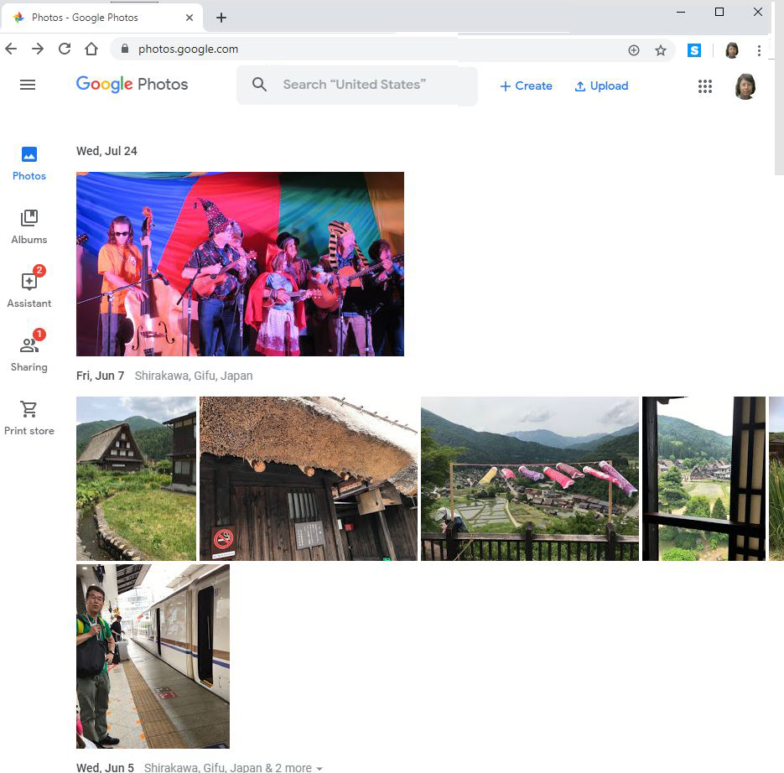
Google Photos

Slide 25
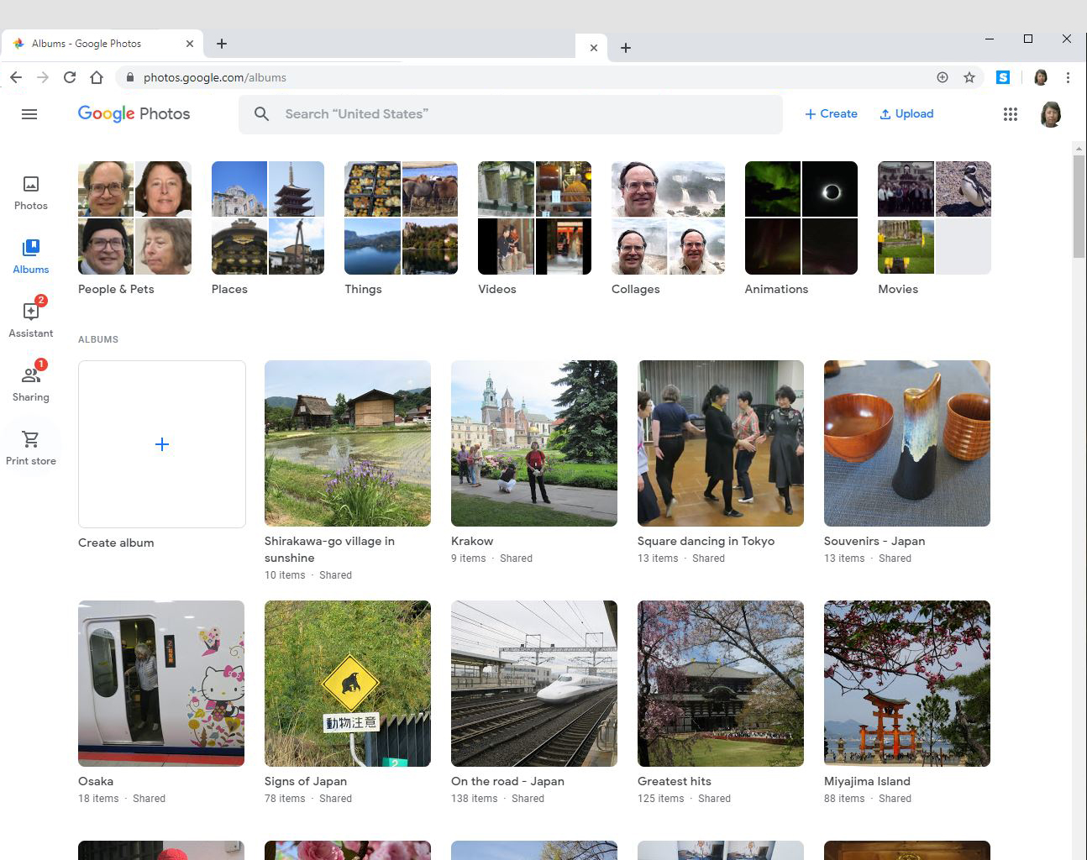
Google Photos (in album view mode)

Slide 26
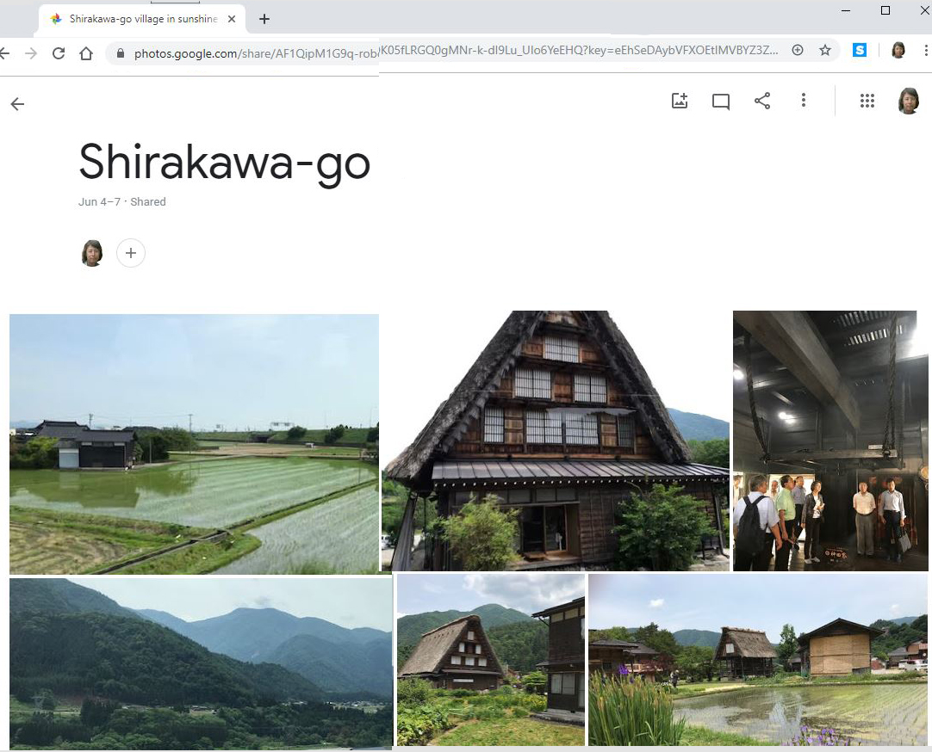
Google Photos Organize album

Slide 27
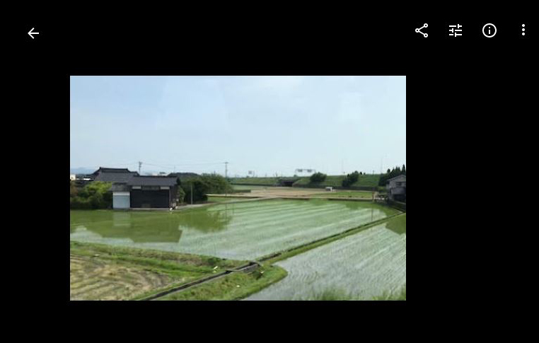
Google Photos edit and share

Slide 28
Dropbox
Available for Windows, Android, Mac, iPhone, iPad
Features in Dropbox personal edition
https://www.dropbox.com/individual/plans-comparison

Slide 29
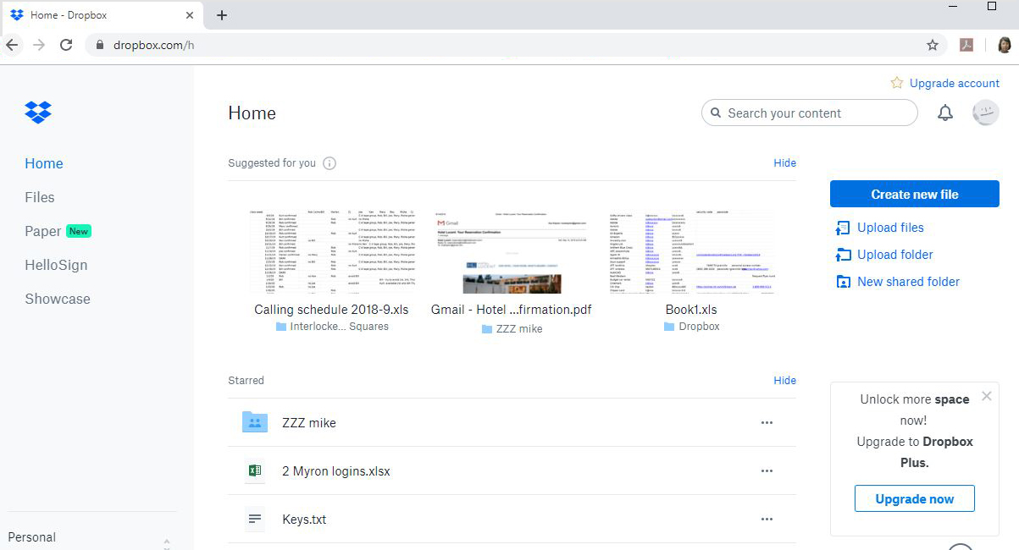
Dropbox

Slide 30
iCloud
Built in to iPhones
Not available for Android
Not recommended for Windows computers
Designed to back up iPhones and iPads

Slide 31
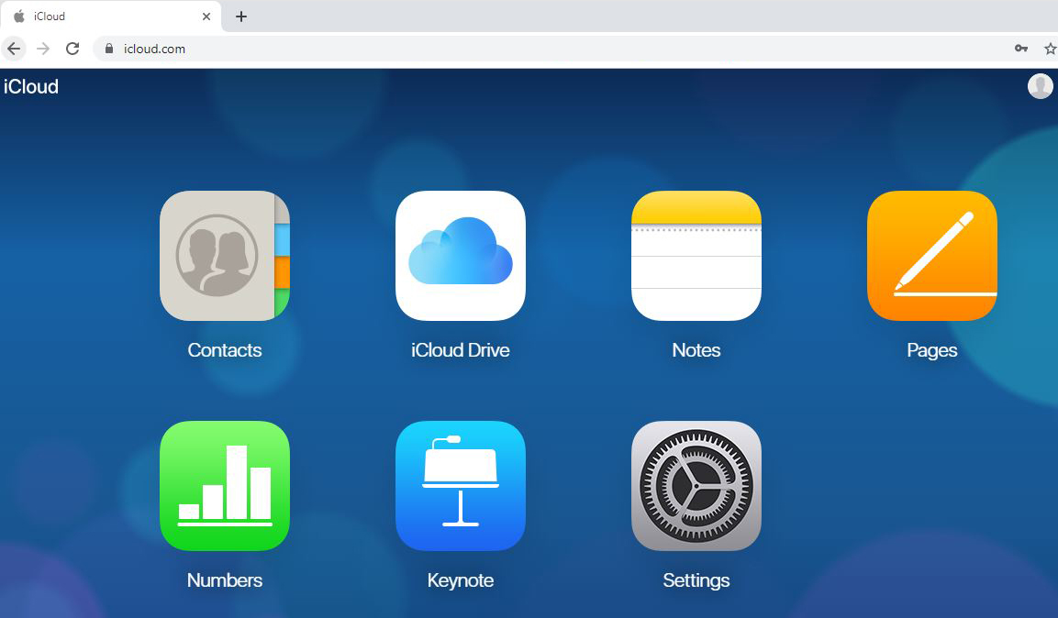
iCloud

Slide 32
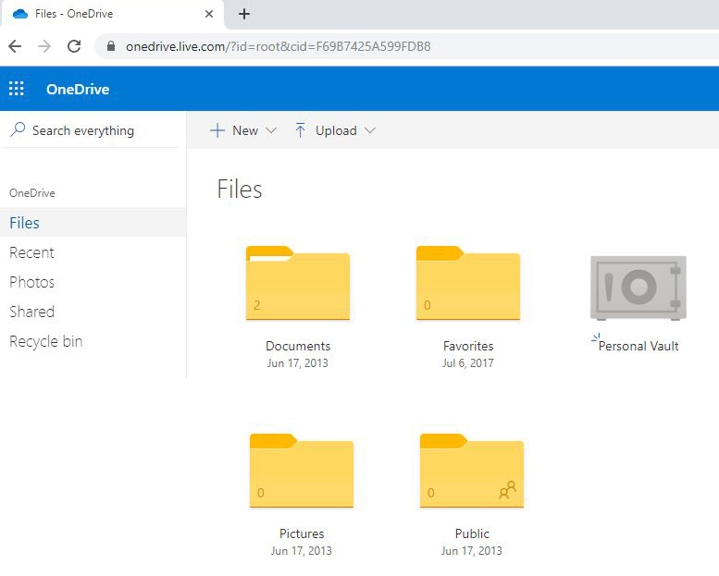
Microsoft OneDrive

