Slide 1
The Internet is Everywhere
May 2018 for Redwood City Computer Club
Sue Kayton
kayton@alum.mit.edu

Slide 2
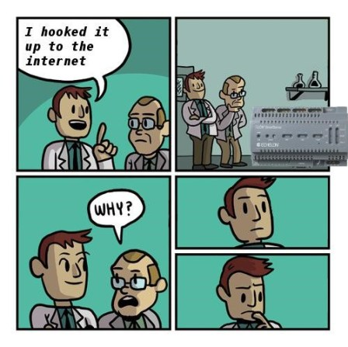

Slide 3
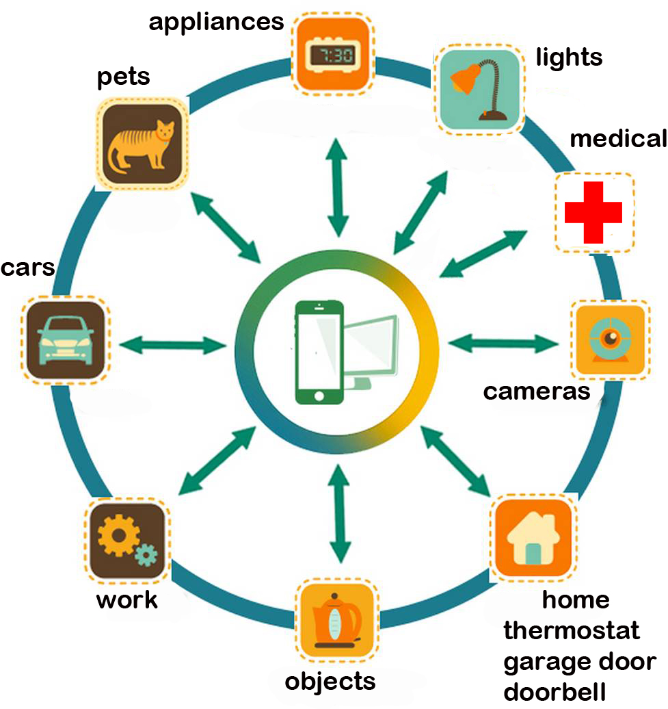

Slide 4
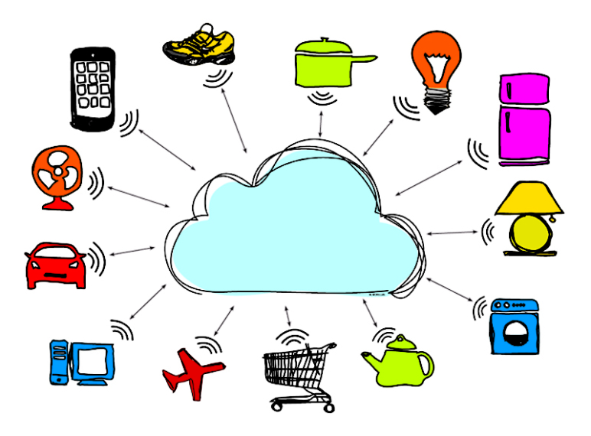

Slide 5
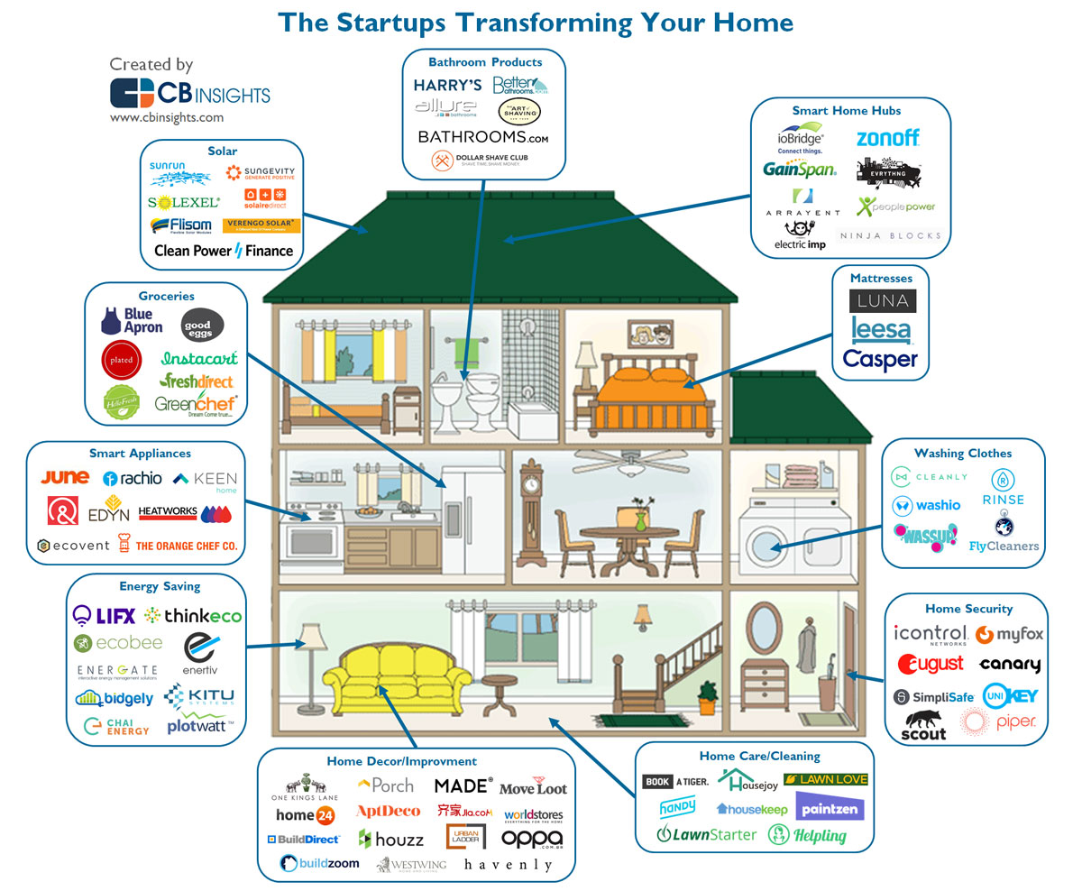

Slide 6
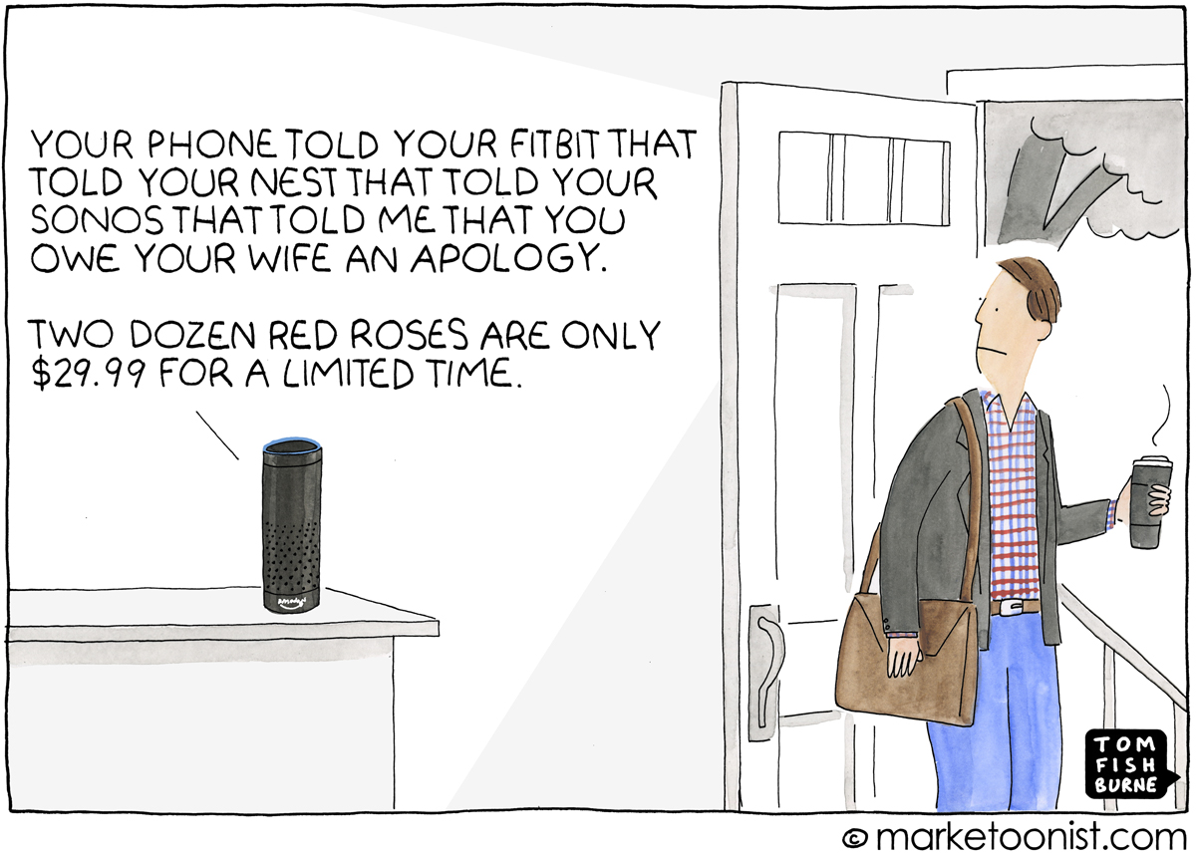

Slide 7
Medical – FitBit, blood pressure monitor, panic button, glucose alert, pill alert
Food – grocery list, turn on CrockPot, hands-free payment
Car – notifications for maintenance and gas, hands-off driving, FasTrak, parking
Home – heat, A/C, doorbell, garage door, security system, lights, washer/dryer
Kids, grandkids, and pets – track location

Slide 8
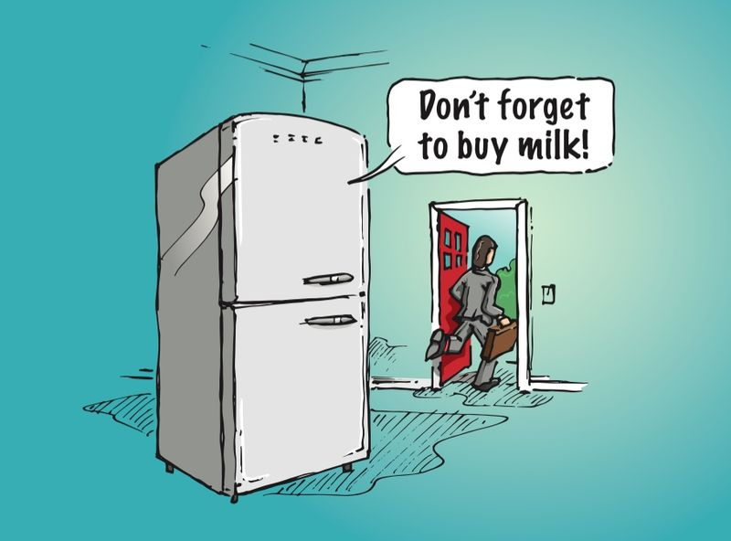

Slide 9
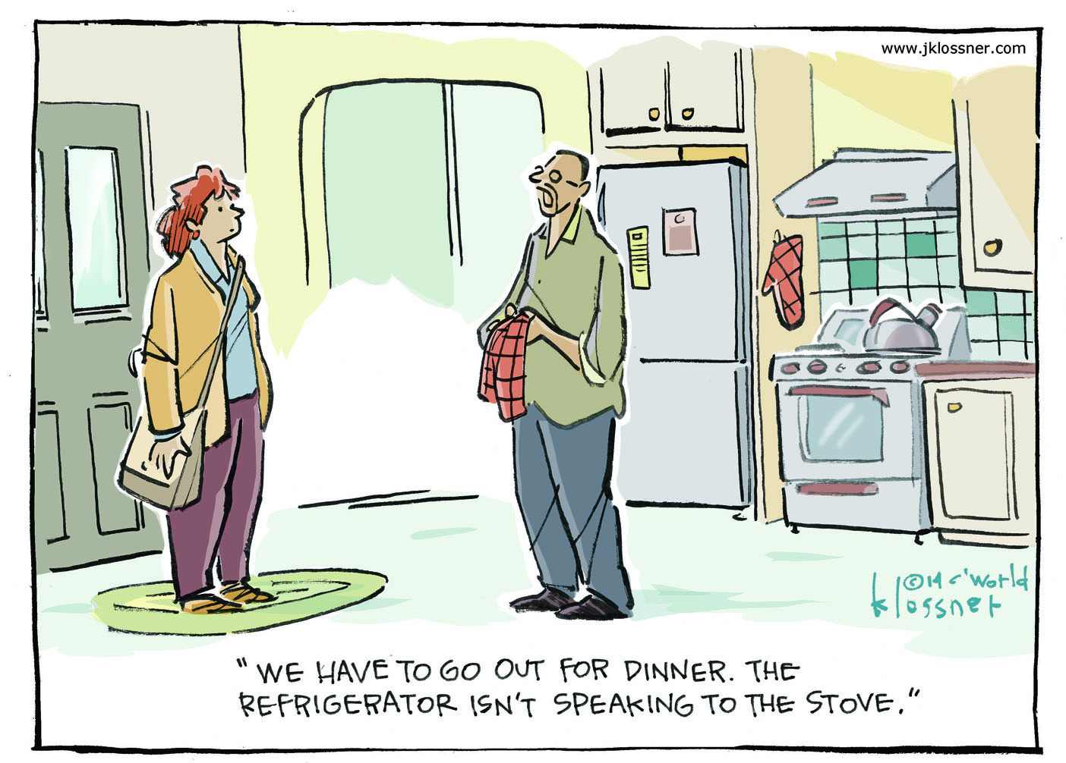

Slide 10
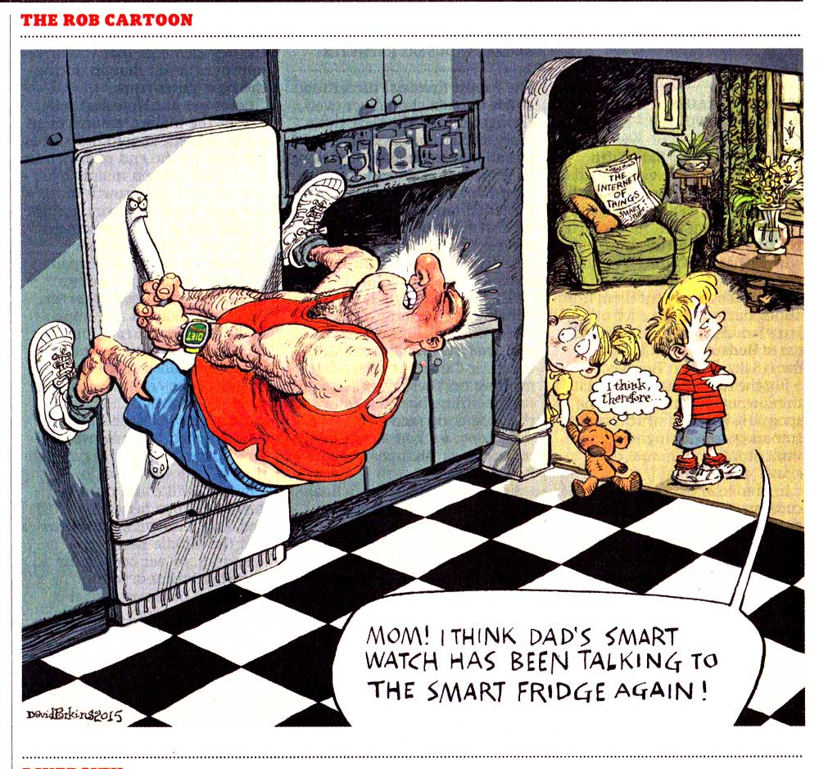

Slide 11
Alexa in action
https://www.facebook.com/ScreenJunkies/videos/10155953204437403

Slide 12
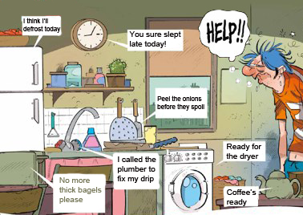

Slide 13
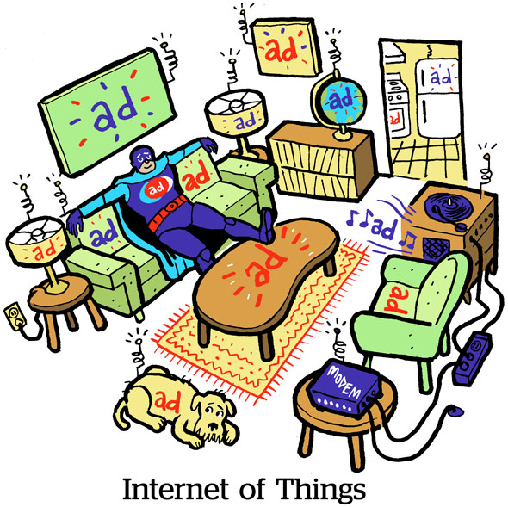

Slide 15
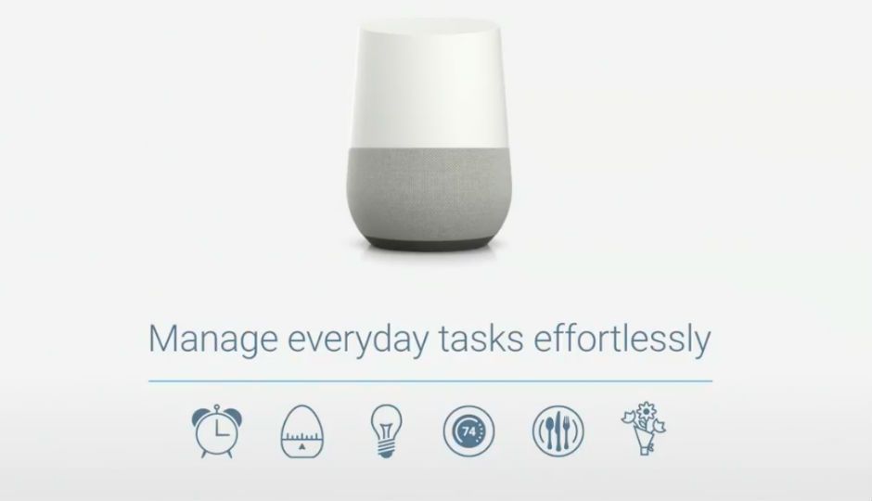
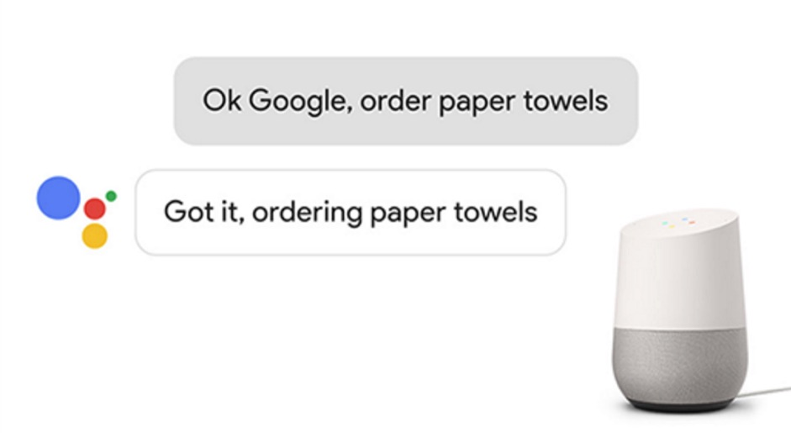

Slide 16
Ring doorbell
Sky Bell

Slide 17
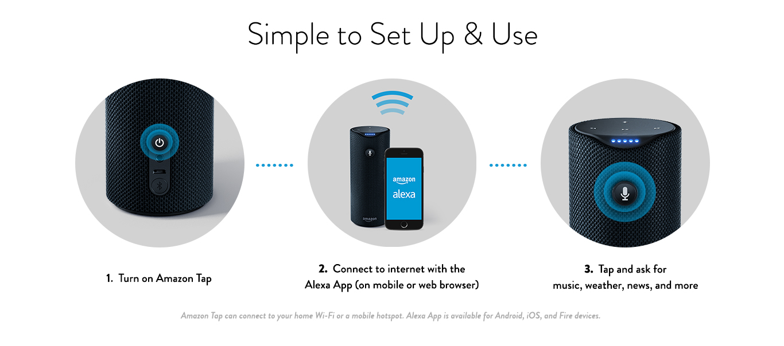

Slide 18
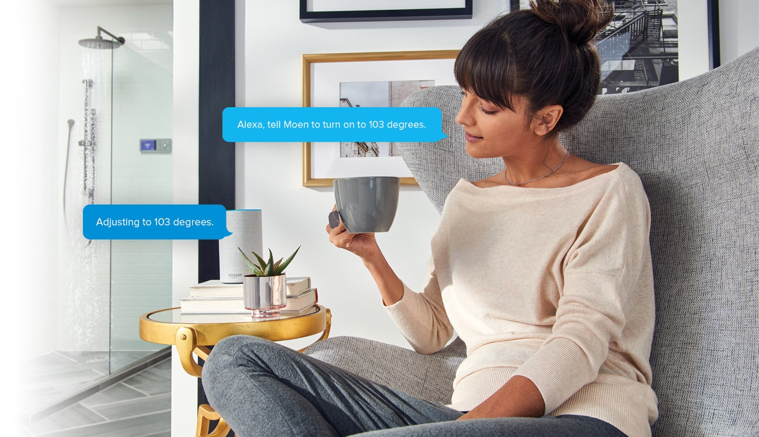

Slide 19
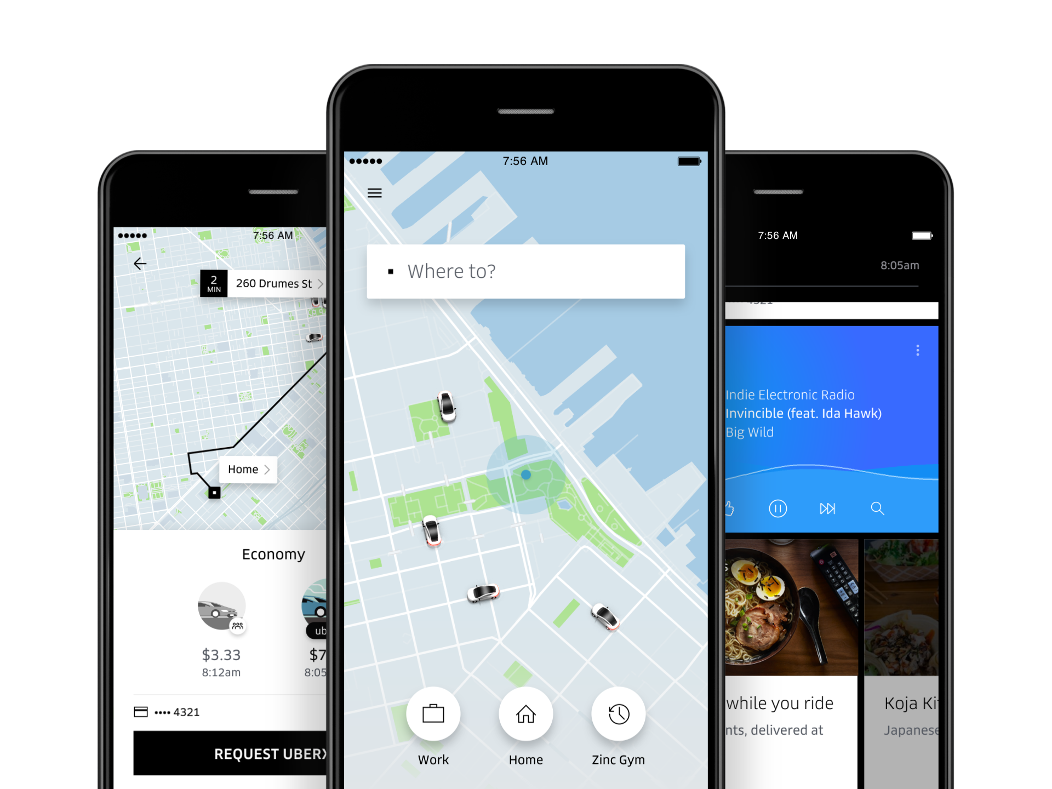
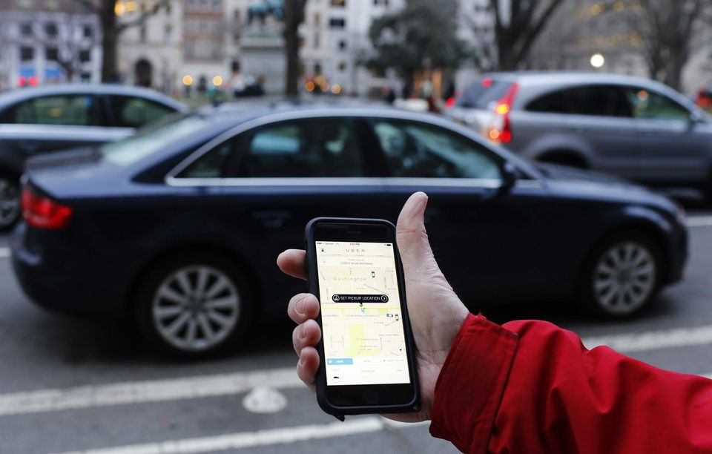
Uber car-sharing

Slide 20
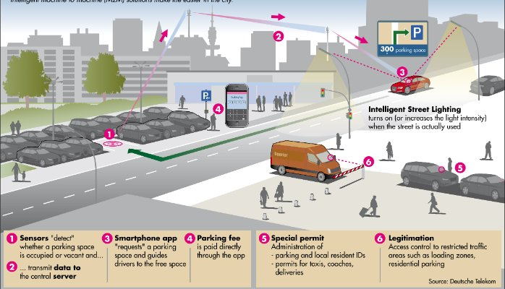

Slide 22
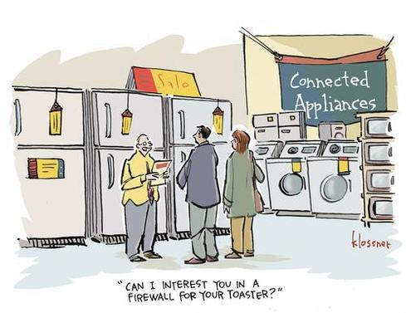

Slide 23
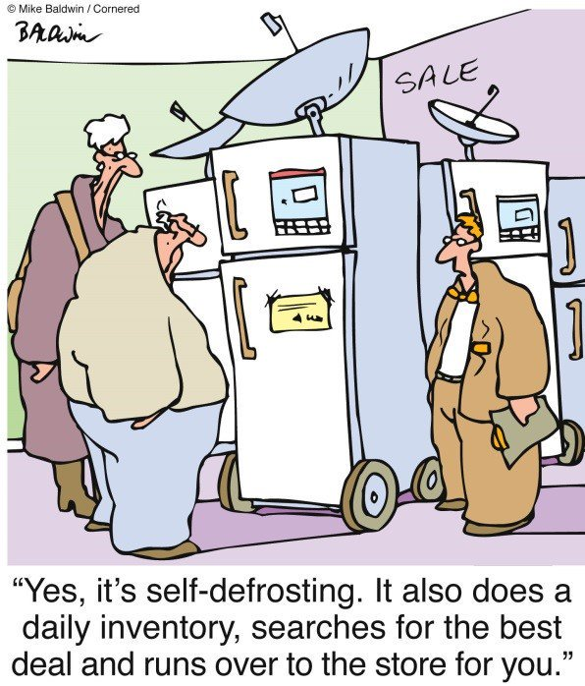

Slide 24
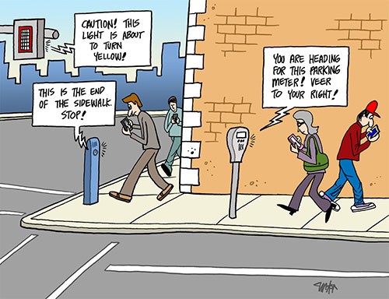

Slide 25
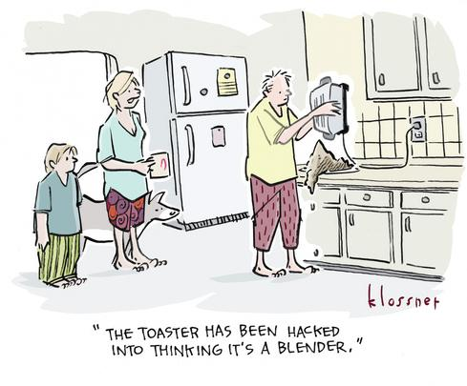

Slide 26
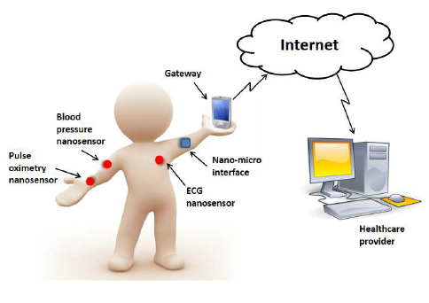

Slide 27
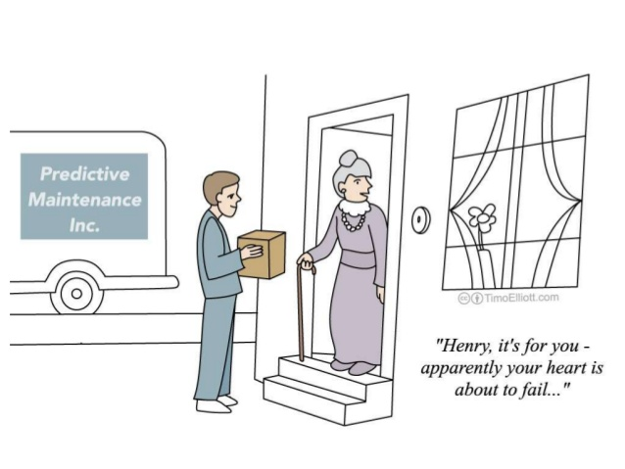

Slide 28
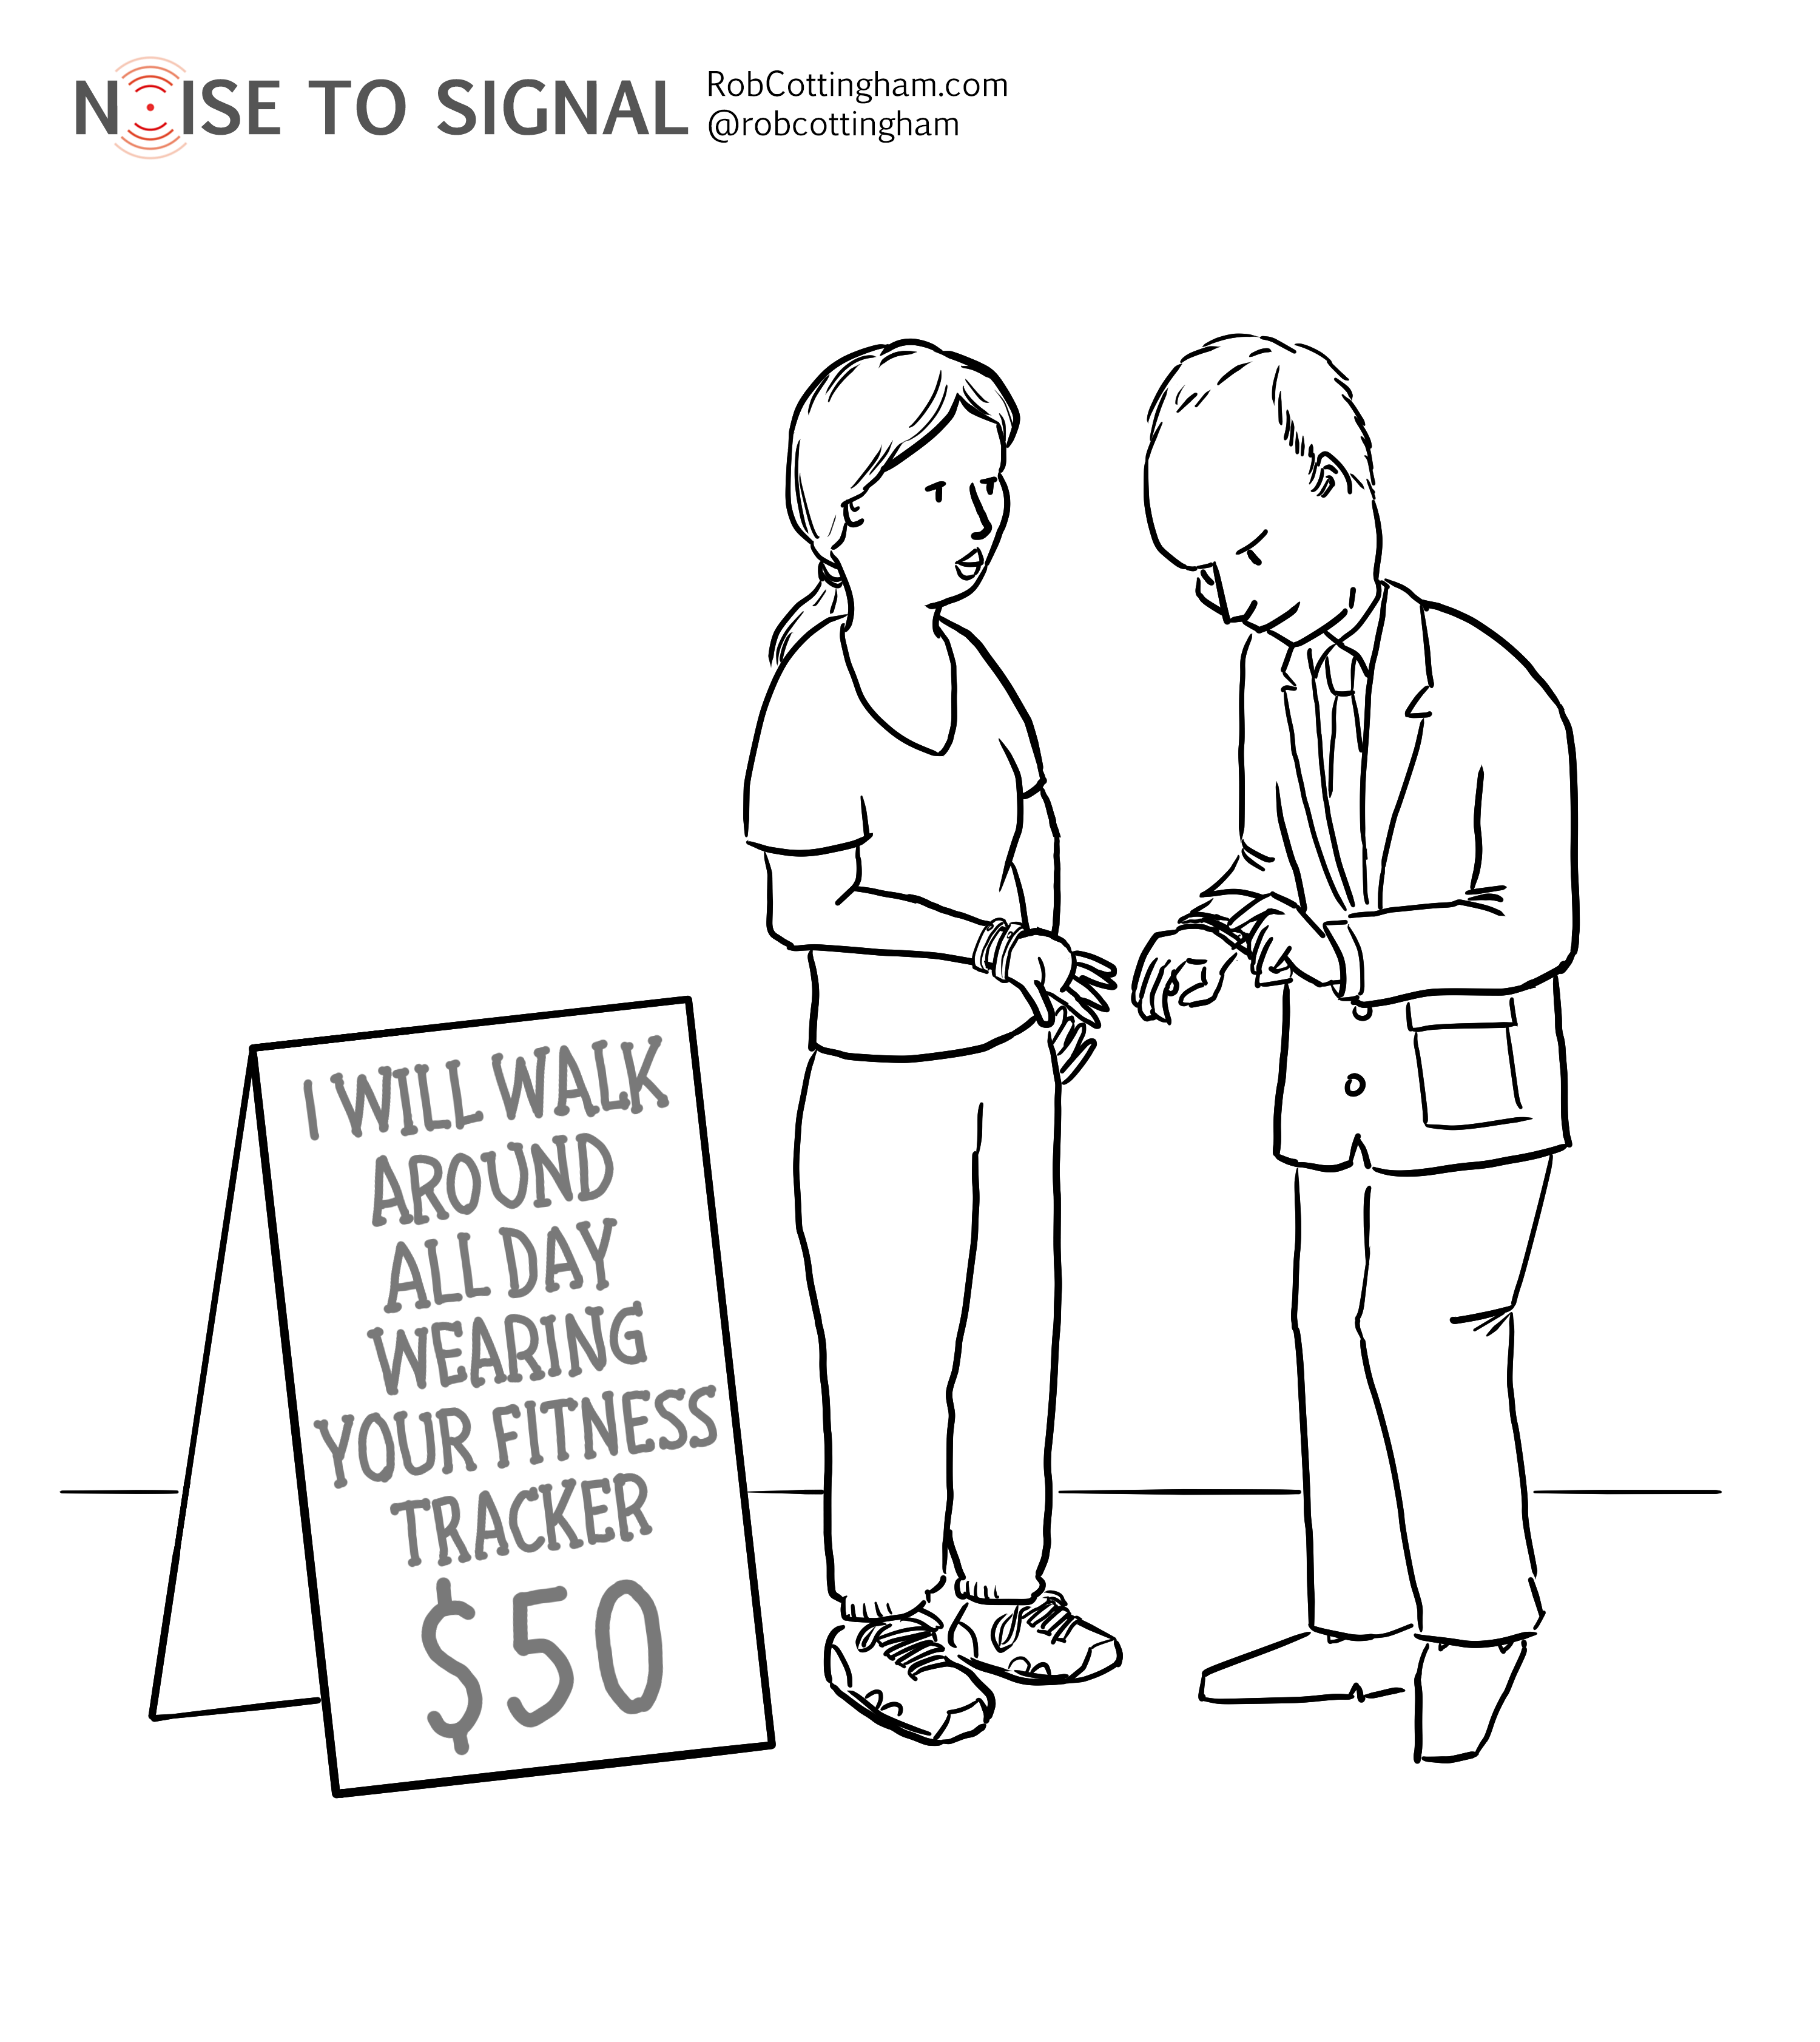

Slide 29
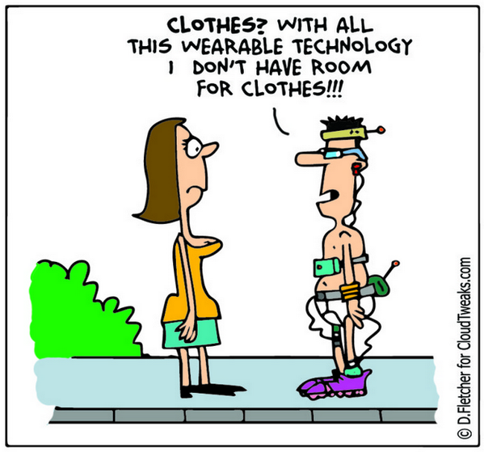

Slide 30
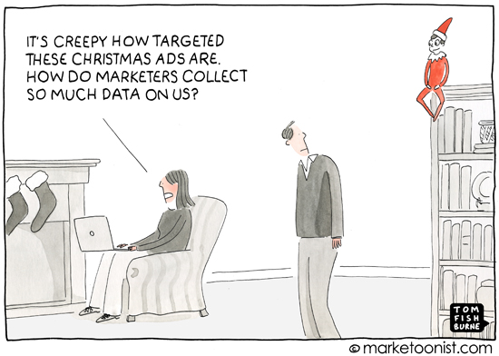

Slide 31
The Internet is Everywhere

Slide 32
Netgear PowerLine WiFi
https://www.amazon.com/NETGEAR-PowerLINE-Wi-Fi-Outlet-PLPW1000-100NAS/dp/B01N5AT8DC

Slide 33
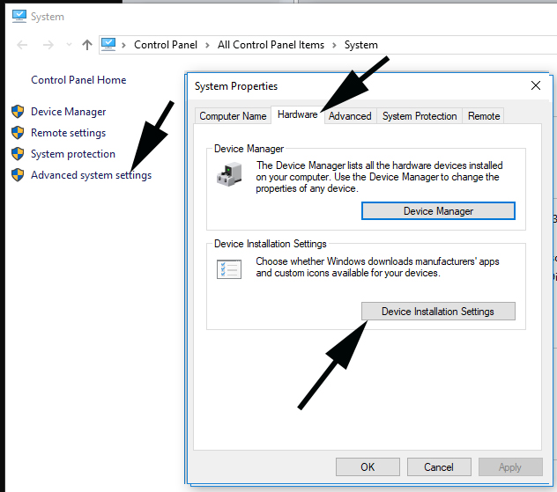
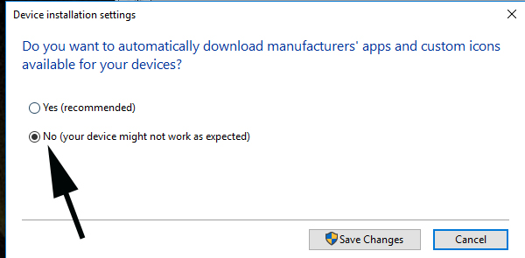
Preventing driver updates in Windows 10

Slide 34
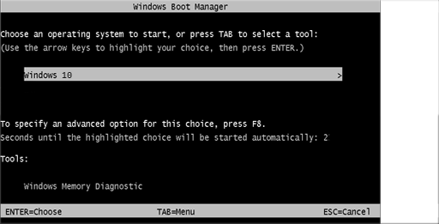
Enabling safe mode on boot in Windows 10
To enable safe mode, open an elevated command prompt and type in the following three lines, one at a time. bcdedit /set {bootmgr} displaybootmenu yes bcdedit /timeout 3 bcdedit /set {default} bootmenupolicy legacy
On boot, the screen above will flash for less than one second. When you see it, immediately press F8 one time and select Safe mode or Safe mode with networking

Slide 35
Package and mail notification
Sign up for email or text alerts when you get packages
FedEx - create an account, then go to Delivery Manager
UPS - create an account then go to My Choice
US post office - sign up for Informed Delivery

Slide 36
Windows April 2018 update (version 1803)
Tested on over 25 computers. Very few problems
File and folder sharing – does not save settings – have to set up from scratch
Recycle bin – changes setting to no confirmation dialog
Printer and device detection – issue on first boot
Games (Solitaire, etc.) get uninstalled

Slide 37
Before installing major Windows update
Housekeeping tasks
Back up data
Do a full system backup
Delete temporary files using Disk Cleanup
Run it twice, second time select Clean Up System Files
Run CHKDSK

